Slide 1
Humanities to Digital Humanities
critical insights, creative designs, speculative imagination, and methods of comparative, historically informed study

Slide 2
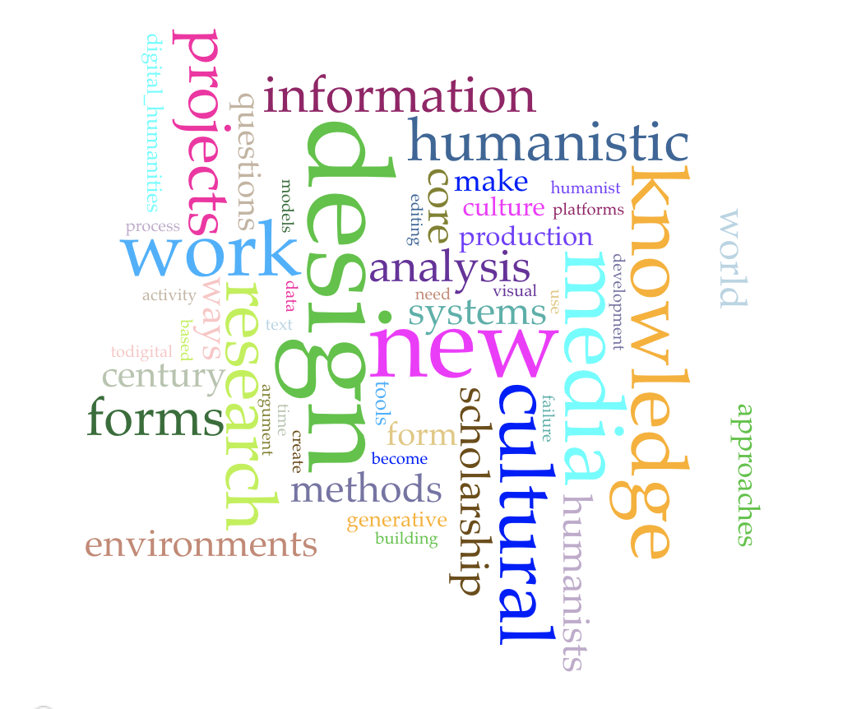
What’s the difference between a book/article & DH project?
Think about this week’s readings...

Slide 3
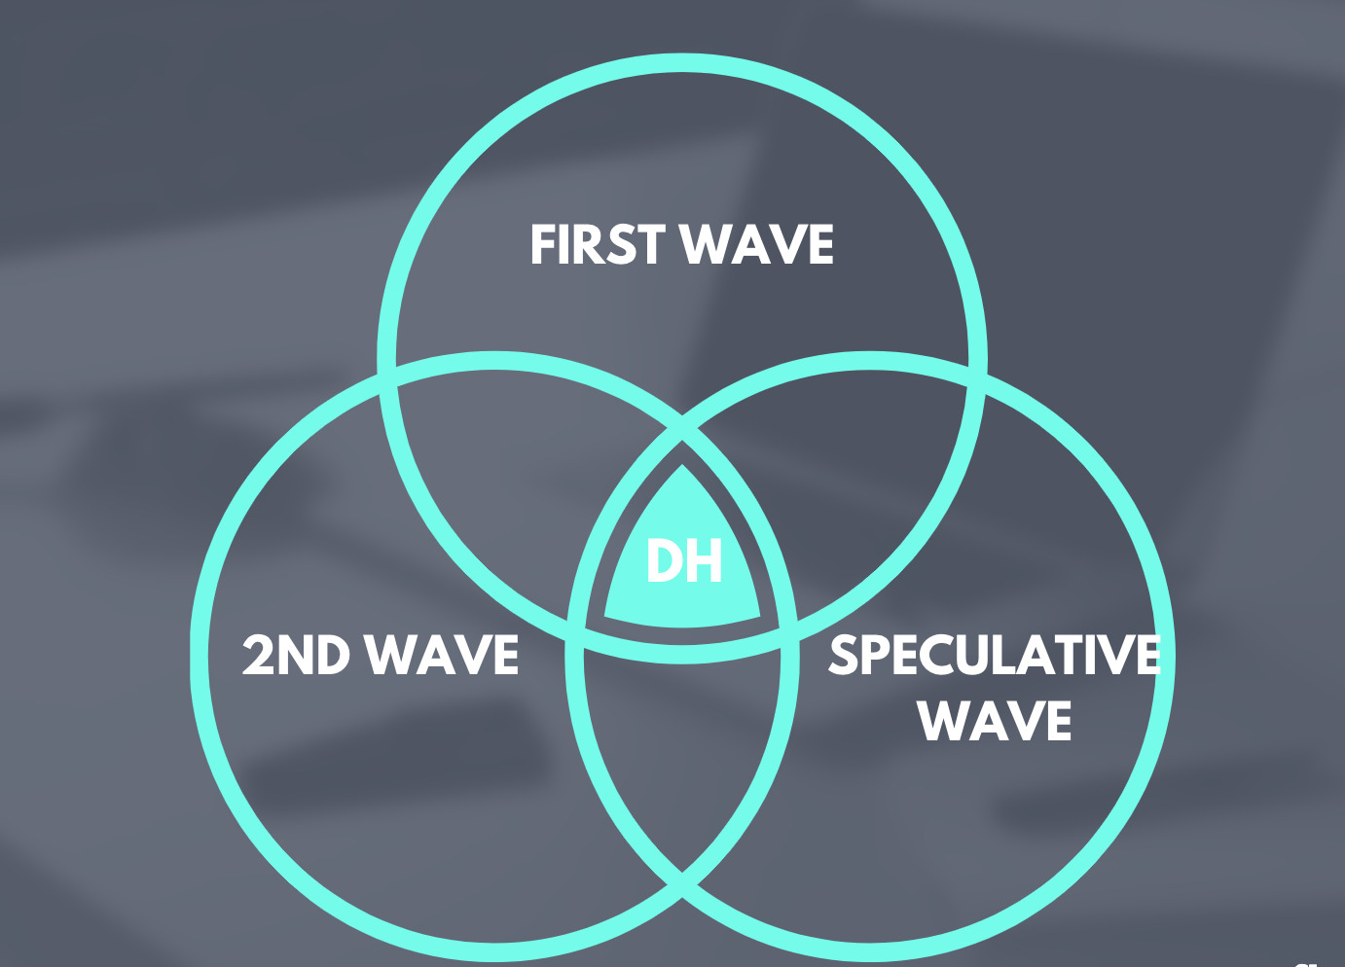
What characterizes each wave?
In groups, discuss and create your own venn diagram--take a picture and post it to the Week 4 forum

Slide 4
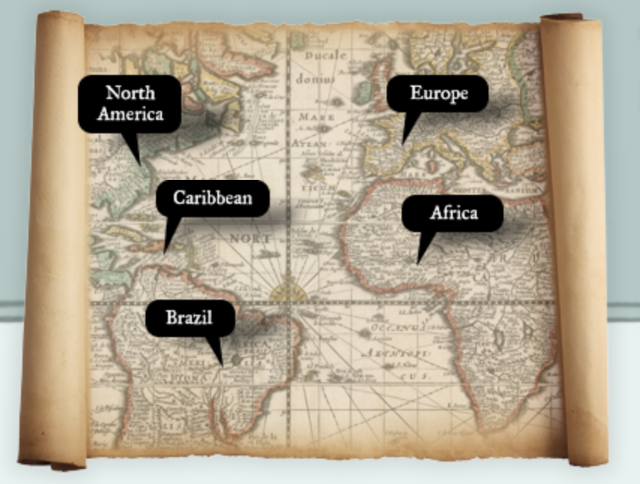
How are DH projects shaped?
In groups, go to the analyzing a DH project document

Slide 5
[D]esign asks: “What if?” Each design iteration plays out an answer to the question: “What happens when...?” In a world with fluid contours, humanists, designers and technologists working together can move beyond considering what can be done with the tools at hand to ask: “What can we imagine doing that may not yet be possible?” (Burdick et al, p. 12)

Slide 6
What Characterizes First-Wave DH Projects
First Wave of DH
Digitization of canonical texts & creators
Audience - other scholars
Scholarly resource
Rossetti Archive
Old Bailey Online
http://www.nineteenthcenturydisability.org/
http://www.songsofthevictorians.com
https://nines.org/ (many projects collected here, so pick one specific one, like "Orlando: Women's Writing in the British Isles."

